Slide 1
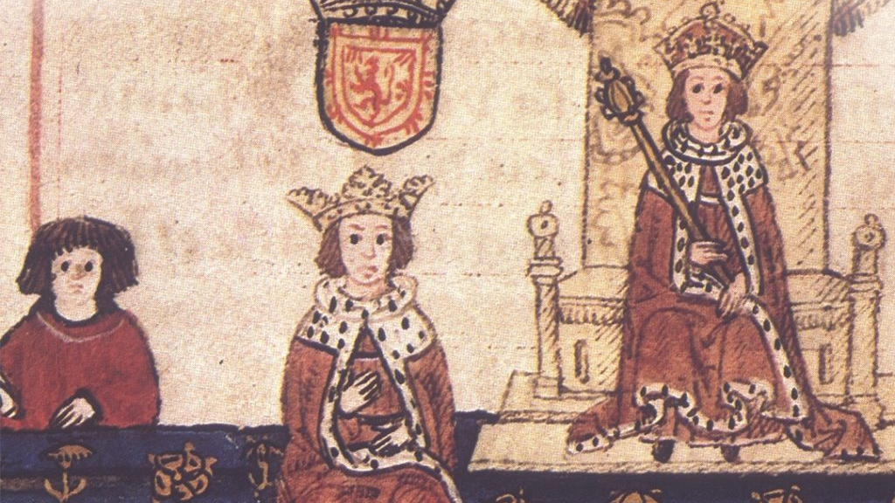
Public Law Lecture 6:
EXECUTIVE AND PREROGATIVE POWERS

Slide 2
Today’s Plan
What are prerogative powers?
Scope of the prerogative powers
Control of the prerogative powers
Prerogative and the statute
The prerogative in case law

Slide 3
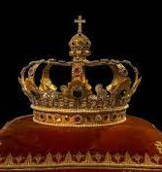
What are Prerogative Powers?
Then: The ‘Royal’ Prerogative
"that special pre-eminence which the King hath, over and above all other persons, and out of the ordinary course of the common law, in right of his regal dignity" (Blackstone)
  Originally exercised by the Monarch alone
  No need to seek Parliament’s consent
  Godden v Hales (1686) 11 State Tr 1166
Now: Prerogative Powers
"the residue of discretionary... authority which, at any given time, is legally left in the hands of the Crown" (Dicey)
“any and every sort of government action which is not statutory” (Wade)
  Exercised directly by ministers or on the advice of the PM or Cabinet → the executive
  Diminishing range
    BBC v Johns [1965] Ch 32, Lord Diplock: “it is 350 years and a Civil War too late” to create new prerogative powers.

Slide 4
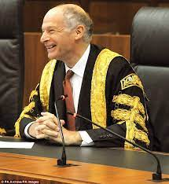
As explained in Miller No 1, at [41] (Lord Neuberger)
Originally, sovereignty was concentrated in the Crown [monarch], subject to limitations which were ill-defined and which changed with practical exigencies.
Accordingly, the Crown [monarch] largely exercised all the powers of the state.
However, over the centuries, those prerogative powers, collectively known as the Royal Prerogative, were progressively reduced as Parliamentary democracy and the rule of law developed.
By the end of the 20th century, the great majority of what had previously been prerogative powers, at least in relation to domestic matters, had become vested in the three principal organs of the state, the legislature (the two Houses of Parliament), the executive (ministers and the government more generally) and the judiciary (the judges).

Slide 5
What kinds of powers are we talking about here?
domestic affairs
Foreign affairs
Appointment and dismissal of ministers*
Summoning, prorogation and dissolution of Parliament*+
Royal Assent to bills*
Grant of peerages, honours and titles*
Appointment and regulation of civil service
Commissioning of officers in the armed forces
Security
Appointment of QCs
Grants of mercy
Grants of royal charters
Regulation of charities
Attorney-General’s powers over legal proceedings
Making of treaties
Declaration of war
Deployment of armed forces
Recognition of foreign states
Accreditation of diplomats
Governance of overseas territories
Grant/revocation of passports
*traditionally performed by Queen personally (usually on the advice of ministers)
+superseded (fully or to some extent) by statute

Slide 6
FOR OUR PURPOSES … THIS CATEGORISATION IS HELPFUL
‘The Royal Prerogative’ is an overarching term that can refer to either, or both, of the following:
The executive prerogative powers – much more day-to-day, e.g. diplomacy; security; making treaties.
The monarch's personal prerogatives ( aka ‘reserve powers’): e.g. proroguing Parliament, appointing the Prime Minister, granting Royal Assent

Slide 7
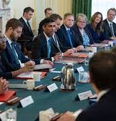
Reminder: what is the executive?
Poole: “It exercises the basic powers of state (military, police, fiscal, diplomatic, organisational) and is responsible for many other functions necessary for social well-being such as health and education. It makes the majority of the policies and rules that structure public life and organizes the most significant part of the public administration.”
Powers in statute, secondary (delegated) legislation, prerogative
Government ministers sitting in the Commons or in the Lords > ministers may be ‘Cabinet’ ministers or ‘junior ministers’
Advised by Parliamentary Private Secretaries and/or Special Advisors
Assisted by the Civil Service
Maximum of 95 paid ministers in the Commons and 109 in total – but there may be more unpaid ministers

Slide 8
What powers are executive prerogatives? See Public Administration Select Committee Taming The Prerogative (2004)
The making and ratification of treaties.
The conduct of diplomacy, including the recognition of states, the relations (if any) between the United Kingdom and particular Governments, and the appointment of ambassadors and High Commissioners.
The governance of British overseas territories. The deployment and use of the armed forces overseas, including involvement in armed conflict, or the declaration of war.
The use of the armed forces within the United Kingdom to maintain the peace in support of the police.
Grant of passports
Grant of pardons and cessation of prosecutions.

Slide 9

Control of the Prerogative
  The problem …
  Significant powers
    exercised by ministers
    wide discretion → cf Dicey
  No need for approval by Parliament
  Lack of democratic control → accountability gap
    “Our claim to be a fully-fledged modern democracy … is undermined by reliance on an anti-democratic source of authority for ourselves.” Public Administration Select Committee Taming The Prerogative (2004)

Slide 10
Control of the prerogative
Politics
law
POLITICS can control the use of prerogative powers by:
  Establishing conventions that say the power can only be used in certain ways, e.g. the Monarch only uses their reserve powers on ministerial advice, or that Parliament should debate a subject first.
  Politicians need to be re-elected; certain uses of the prerogative might lose (or gain!) them votes.
  Mechanisms for parliamentary scrutiny of executive actions are already in place, these include the vote of censure or no-confidence, adjournment debates, debates on a motion, parliamentary questions, ministerial correspondence and scrutiny by select committee.
LAW can control the use of executive prerogative powers by:
  Abolishing the power through an Act of Parliament
  Using an Act of Parliament to limit an existing prerogative without abolishing it
  Judicial review can ensure that the government uses prerogative powers in a way that is within their legal scope – IF it is ‘justiciable’.

Slide 11
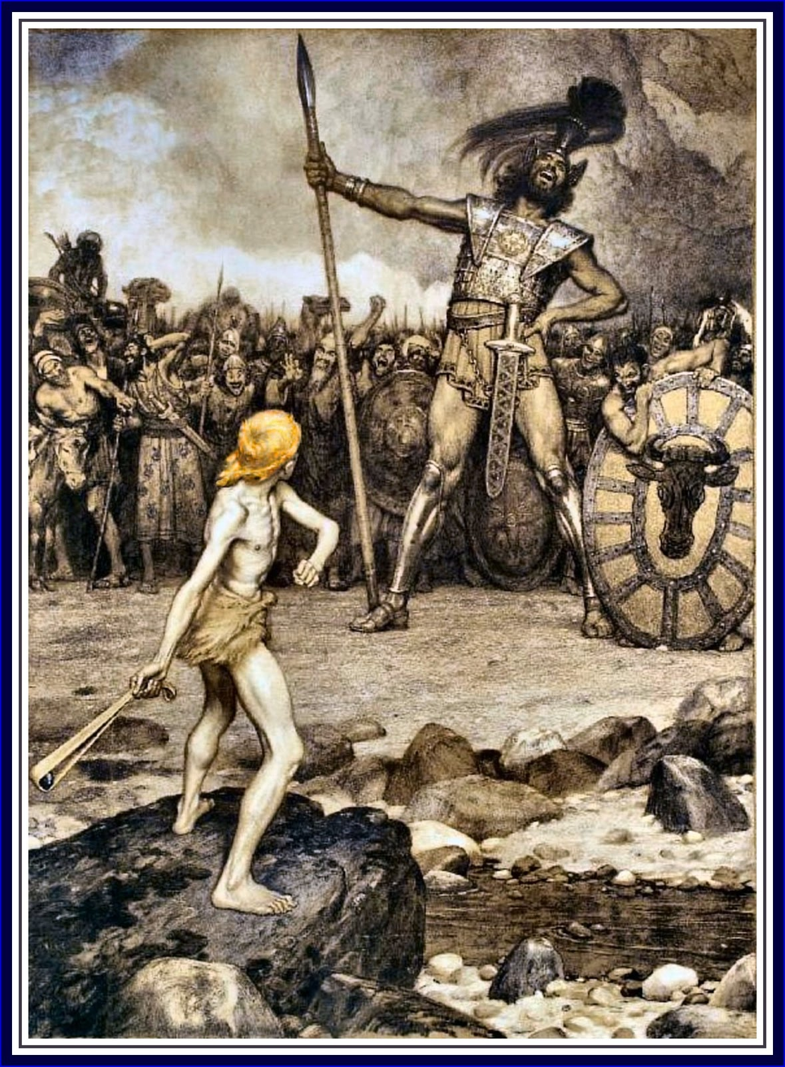
Prerogative and Statute
Statute may abolish a prerogative power
  “[T]he principle is clearly established that the … prerogative cannot be restricted or qualified save by express words or by necessary intendment” British Coal Corporation v The King [1935] AC 500
Prerogative must give way to statute
  Attorney-General v De Keyser's Royal Hotel [1920] AC 508 → precedence of statute; prerogative cannot be ‘revived’
  “if the whole ground of something which could be done by the prerogative is covered by the statute it is the statute that rules” (Lord Dunedin)
  R v Secretary of State for the Home Office ex parte Northumbria Police Authority [1989] QB 26 → statute and prerogative co-exist → controversial
Parliament’s will, as enacted in statute, takes priority
  Laker Airways Ltd v Department of Trade [1977] QB 643 (CA)
    Prerogative must be used to further, not frustrate, Parliament’s intention → cannot revoke Laker Airways’ designated airline status
      Miller No 1 → government cannot use prerogative powers to start the ‘Article 50’ process because this would frustrate Parliament’s intention to be a member of the EU, as set out in the European Communities Act 1972. Only Parliament can choose to change this decision and leave.
  R v Secretary of State for the Home Department ex parte Fire Brigades Union [1995] 2 All ER 24
    Minister may not refuse to bring statute into effect and use the prerogative instead

Slide 12
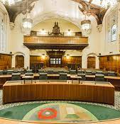
Prerogative in case law
Judicial Review
A reluctance to review exercise of prerogative?
  China Navigation [1932] 2 KB 197 → ‘the courts cannot question it’
  Hanratty v Lord Butler of Saffron-Walden (1971) 115 Sol Jo 386 → prerogative of mercy cannot be questioned
Cases look at existence, extent/scope
  Re Petition of Right [1915] 3 KB 649
  De Keyser’s Royal Hotel [1920] AC 508
  Burmah Oil Ltd v Lord Advocate [1965] AC 75
  Ex parte Northumbria Police Authority [1989] QB 26
‘Justiciability’ and ‘Deference’
  Miller 1 “In Burmah Oil … Lord Reid described prerogative powers as a “relic of a past age”, but that description should not be understood as implying that the Royal prerogative is either anomalous or anachronistic. There are important areas of governmental activity which, today as in the past, are essential to the effective operation of the state and which are not covered, or at least not completely covered, by statute. Some of them, such as the conduct of diplomacy and war, are by their very nature at least normally best reserved to ministers.”

Slide 13
Council of Civil Service Unions v Minister for the Civil Service [1984] UKHL 9 (The GCHQ CASE)
Civil servants used to have their employment regulated through the prerogative via Orders-In-Council and not through contracts.
Most employees at GCHQ were classed as civil servants and belonged to relevant trade unions.
The Minister for the Civil Service (the PM) used an Order-In-Council to forbid GCHQ employees joining a union, without any consultation.
Can this exercise of the prerogative be challenged?
ON THE FACTS: the use of the prerogative cannot be questioned
NB: National security

Slide 14
THE GCHQ case: the broader judgment
reviewability
justiciability
“I am unable to see … why the fact that the source of the power is the prerogative and not statute should today deprive the citizen of that right of challenge to the manner of its exercise which he would possess were the source of the power statutory. In either case the act in question is the act of the executive. To talk of that act as the act of the sovereign savours of the archaism of past centuries” (Lord Roskill)
House of Lords decides that exercise of the prerogative is reviewable BUT …
“I do not think that that right of challenge can be unqualified. It must, I think, depend upon the subject matter of the prerogative power which is exercised” (Lord Roskill)
Some prerogatives not ‘justiciable’
  Non-justiciable issue = one where many competing points of view to be weighed and balanced in search for political solution
  National security a “par excellence” example
  Making of treaties, defence of the realm, prerogative of mercy, grant of honours, dissolution of Parliament, appointment of ministers
  High v low policy → R (Gentle) [2008] UKHL 20: “peace and war, the making of treaties, the conduct of foreign relations” (Lord Bingham at [8]) → cf ex parte Rees-Mogg (1994) 1 All ER 457

Slide 15
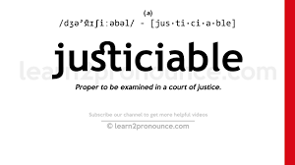
Justiciability after GCHQ
Increasing range of prerogative powers deemed justiciable
    ex parte Everett [1989] 1 All ER 655 → power to issue passport
    ex parte Bentley (1993) 4 All ER 442 → power to grant a pardon/mercy
    R (Abassi) v Secretary of State for Foreign Affairs [2002] EWCA Civ 159 → suggestion that refusal to make diplomatic representations is justiciable
    R (on the application of Bancoult) v Secretary of State for Foreign and Commonwealth Affairs [2007] EWCA Civ 498 → removal of inhabitants from British dependent territory reviewable; confirmed by House of Lords in Bancoult No 2 [2008] UKHL 61
    R (Miller) v Secretary of State for Exiting the European Union [2017] UKSC 5 (Miller 1) → attempt to trigger Article 50 using prerogative
    “It is worth emphasising that nobody has suggested that this is an inappropriate issue for the courts to determine”

Slide 16
Justiciability after GCHQ:
R (Miller and Cherry) v The Prime Minister [2019] UKSC 41 (Miller 2)
Among those prerogative powers which remain in the hands of the Crown is the power to prorogue Parliament
The cardinal convention necessitates that the exercise of these powers only occurs upon the advice of the Prime Minister, or members of the Cabinet
Prorogation (pronounced 'pro-ro-ga-tion') marks the end of a parliamentary session. It is the formal name given to the period between the end of a session of Parliament and the State Opening of Parliament that begins the next session. The parliamentary session may also be prorogued before Parliament is dissolved.
The Queen formally prorogues Parliament.
Prorogation usually takes the form of an announcement, on behalf of the Queen, read in the House of Lords. It is made to both Houses and the Speaker of the House of Commons and MPs attend the Lords chamber to listen to the speech.
Prorogation brings to an end nearly all parliamentary business.

Slide 17
Case Background:
June 2016
‘Brexit’ referendum votes ‘Leave’.
Feb. 2017
Miller v Secretary of State for Exiting the European Union [2017] UKSC 5. Article 50 can only be triggered with Parliament’s permission – leads to the European Union (Notification of Withdrawal) Act 2017.
Mar. 2017
Article 50 triggered, starting a 2-year period for negotiations.
Nov. 2018 – Mar. 2019
Theresa May negotiates a withdrawal agreement; Parliament rejects it three times. Eventually she is forced to resign as PM.
Apr. 2019
Article 50 period is extended until 31 October 2019.
July 2019
Boris Johnson becomes Prime Minister, promising a new withdrawal agreement
Sep. 2019
Boris Johnson advises the Queen to prorogue Parliament for 34 days.

Slide 18
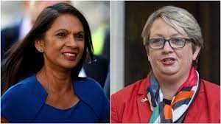
The arguments
Miller and Cherry
  The Prime Minister was essentially trying to force Parliament either to a) approve any deal that he negotiated or b) accept ‘No Deal’ at the end of October, without proper scrutiny.
  The Prime Minister’s advice to the Queen, that led to the prorogation, was justiciable.
  The advice given to the Queen was an unlawful use of the prerogative because it prevented Parliament from carrying out its proper constitutional role.
  The prorogation should therefore be ruled null and void.
The Government
  The prorogation advice was not justiciable because it was ‘high policy’.
  This was a political decision, made for political reasons, and accountability for this decision should come from Parliament and the electorate, not from the judiciary.
  The courts were not the appropriate place to hear these arguments.

Slide 19
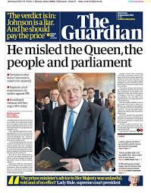
The judgment
The advice was justiciable
The UKSC did not need to consider whether this was ‘high policy’, and instead focused on identifying the scope of the power to prorogue, which is a well-established legal principle [37], [52] → “every prerogative power has its limits, and it is the function of the court to determine, when necessary, where they lie.”
The scope of the power must be understood in its constitutional context. Prorogation prevents Parliament from sitting and is usually very short. Parliamentary sovereignty and the accountability of the executive to Parliament are fundamental constitutional principles. Prorogation must not prevent those principles from operating without good reason [50]
34 days would prevent those principles from operating. The government provided no reason at all for the prorogation [61]
https://trinitycollegelawreview.org/miller-cherry-and-the-justiciability-of-prerogative-powers/

Slide 20
Summary
Prerogative powers used to be exercised solely by the monarch
The majority of prerogative powers are now exercised by members of the executive
Courts were reluctant to subject the exercise of prerogative powers to judicial review, though were content to determine the powers’ existence and extent
After the GCHQ case, the exercise of prerogative powers became increasingly justiciable
Some prerogative powers remain non justiciable e.g. the making of treaties

Slide 21

ANY QUESTIONS?

